Slide 1
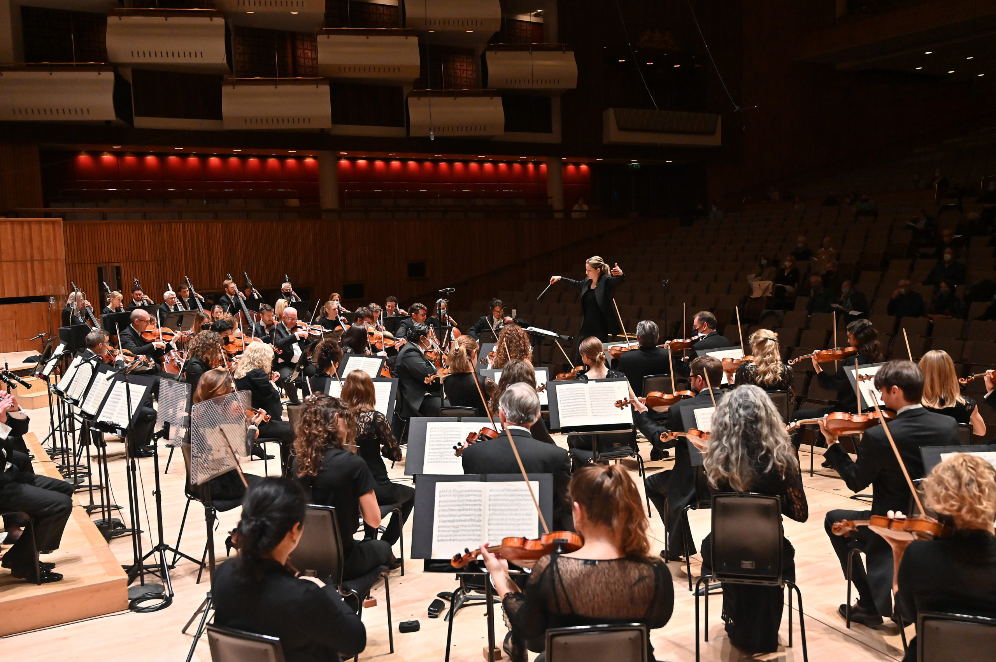
GCSE BrightSparks
Resources
BrightSparks is generously funded by the Rothschild Foundation with additional support from the Candide Trust, Dunard Fund, Rivers Foundation, Mrs Philip Kan, Gill and Julian Simmonds and Garfield Weston Foundation
© Rachel Leach and the London Philharmonic Orchestra 2024

Slide 2
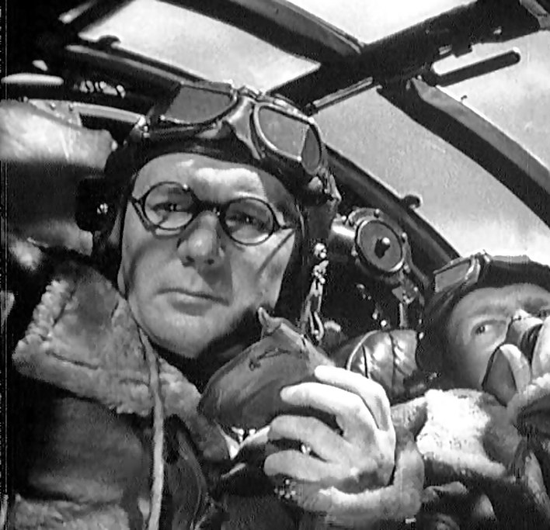
Eric Coates
(1886 – 1957)
The Dam Busters March
(1955)

Slide 3
Eric Coates
(1886 – 1957)
Eric Coates was born in Nottinghamshire to a musical family – although his parents were reluctant to let him pursue a career in music!
He studied composition and viola at the Royal Academy of Music, and then began playing in symphony orchestras, including under conductor Thomas Beecham (who founded the LPO!)
In 1919 he gave up the viola and made his living solely through composing
Some of his most well-known works include ‘By the Sleepy Lagoon’ (1930), the London Suite (1932), and ‘The Dam Busters March’ (1955)

Slide 4
The Dam Busters (1955)
The Dam Busters is a British war film directed by Michael Anderson, based on the true story of Operation Chastise, when the RAF attacked 3 dams in Nazi Germany in 1943
It stars Richard Todd and Michael Redgrave, and was Britain’s biggest box-office success of 1955, receiving rave reviews for the acting, direction, special effects photography and the soundtrack score by Eric Coates
It has become a British classic!

Slide 5
Hear the LPO perform The Dam Busters March
https://www.youtube.com/watch?v=baAqOQu7p7o

Slide 6
Dam Busters March analysis

Slide 7
Introduction (bars 1 – 6)
Long rumbling dominant pedal (G in C major) to add suspense
Pedal = a long note usually underneath the texture underpinning the harmony
The rest of the introduction is based on the famous main march theme (here in F major but the introduction is in C):

Slide 8
Introduction (bar 7 – Figure 1)
Coates fragments the main theme, meaning that we don’t hear all of it, just a shorter bit
He uses a technique called diminution, which means that the note values are shorter
He also uses a sequence, repeating the same short idea on higher pitches

Slide 9
First theme – jaunty, happy tune (Figure 1 – Figure 3)
Contrasts with the main march tune
Begins with a chromatic anacrusis
Anacrusis = begins before the 1st beat of the bar
Chromatic = rising or descending in semitones
In home key of C
Dotted rhythms to create a happy feeling, and a sense of Blitz spirit

Slide 10
Structure:
Introduction
Jaunty theme
Main March theme (Figure 3 – Figure 7)
After this, there is no new material except:
Countermelody (a secondary melody usually less prominent than the main melody) – here it is so good that it almost attracts attention away from the main theme!
New orchestration – different instruments play each part
Different moods and speeds

Slide 11
Coda (Figure 14 – end)
Coda = the ending section of a piece
Uses the main theme one more time, this time augmenting the note values at the end, which means stretching them out and lengthening them
The final coda uses a fragment of the main theme
It shifts the theme from F major to Ab major for a lovely final chord progression: IV – bVI – I in C major
Pounding timpani plays I-V-I-V-I (Hollywood-style ending)

Slide 12
Quiz
How does Coates create a feeling of suspense at the beginning of the piece?
What is the difference between diminution and augmentation?
What is the mood of Coates’s first theme?
What is the technical term for the second melody that is performed alongside the Main March theme in the middle of the piece?
Which instrument creates the Hollywood feel at the end?

Slide 13
Quiz answers
How does Coates create a feeling of suspense at the beginning of the piece? - With a long, rumbling dominant pedal
What is the difference between diminution and augmentation? - Diminution is when you shorten the note lengths. Augmentation is when you extend them
What is the mood of Coates’s first theme? - Jaunty and happy
What is the technical term for the second melody that is performed alongside the Main March theme in the middle of the piece? - The second melody is called the countermelody
Which instrument creates the Hollywood feel at the end? - Timpani

Slide 14
Bonus question:
As you listen to the piece, have a think about how different aspects of the music reflect the theme and story of the film. What features of the music tell you that this is a film about the Second World War?

